Slide 1

Ranking Analysis for Online Customer Reviews
Team Guide: B.JALENDER (Associate Professor)
Dr. Y.Usha Rani (Assistant Professor)
Team Members:
Sai Shiva Gampa 18071A1274
Varshitha Peram 18071A12A0
Sai Sreemanth 18071A12A6
Sumanth V 18071A12B1

Slide 2
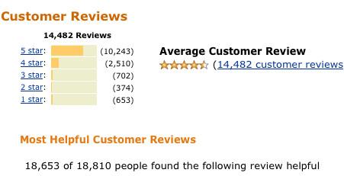
Importance of Customer Reviews
Customer Opinions play a very crucial role in daily life. When we have to make a decision, the opinions of other individuals are also considered. Nowadays many web users post their opinions for many products through blogs, review sites, and social networking sites.

Slide 3
Introduction
Since, there are numerous brands that are present in the market; selecting one will be a tough task for a consumer. The advancement of E-Commerce influences the buying routine of customers. Buyers make the desired decision centered on the reviews present in E-commerce (the ratings and summary of relevant text about the items can well be utilized aimed at decision making).
Few cases have been identified where people post incorrect reviews to defame a brand, or sometimes exquisite reviews are posted to increase the sales of a product. Hence it is important to detect certain opinions and eliminate the rest. The real reviews can further be classified into positive and negative opinions, and sentiment analysis is performed on this data to finally rate different products to help the customer select one out of them.

Slide 4

Problem Definition
Detection of fake reviews, process only genuine reviews by performing opinion mining and review rating mechanism is provided in this study. This system gives each review a score based on a variety of factors.

Slide 5
Dataset
The dataset we selected is the Amazon product reviews. It is a large dataset of records upto 6 lakhs which consists of a unique parameters about the product and the reviewers

Slide 6
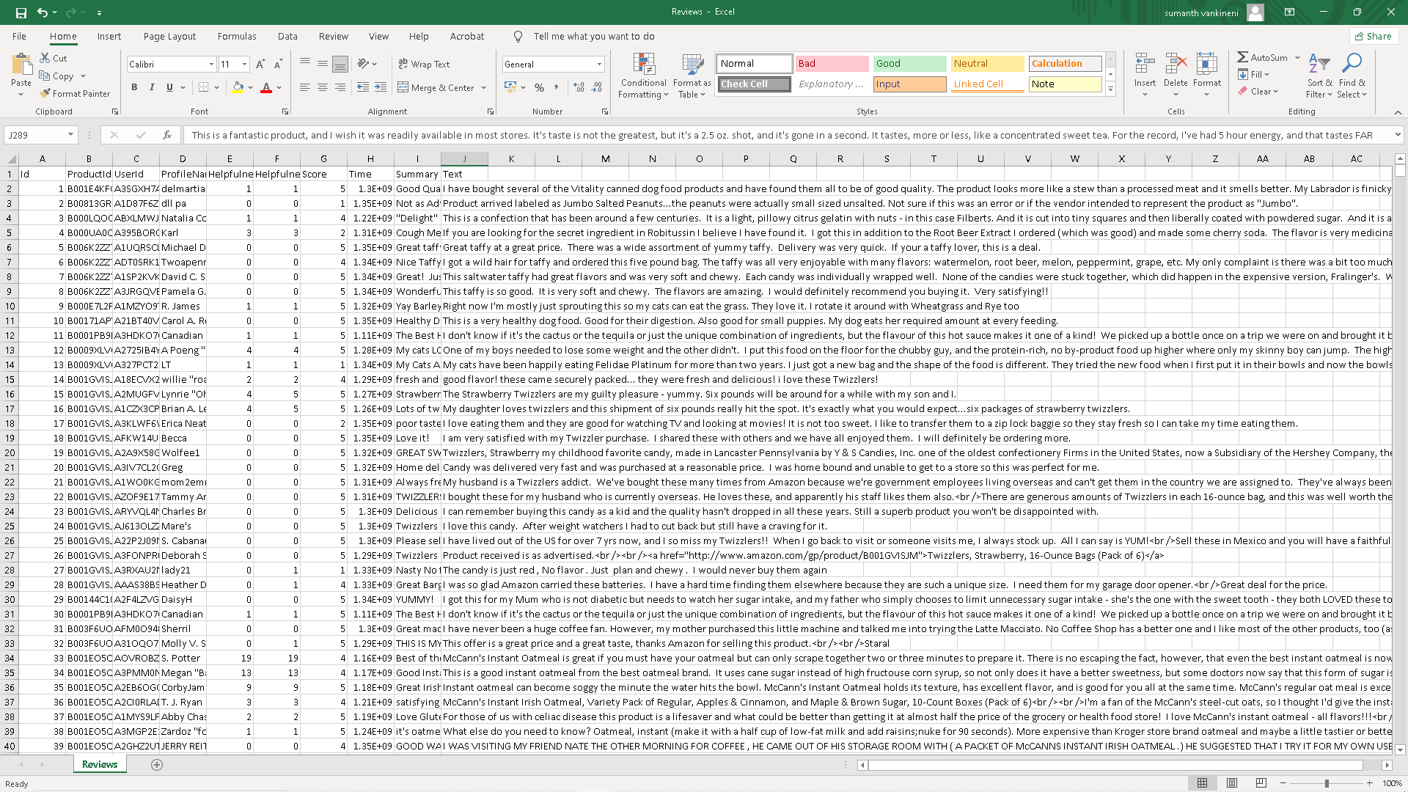

Slide 7
Existing System
At the moment, websites like Amazon use machine learning algorithms to select relevant features and determine a product's final rating. It does not, however, use an algorithm to determine whether a review is genuine or not. While some websites, such as Yelp.com and Fakespot.com, can be used to spot fraudulent reviews on the internet, there is no universally accepted algorithm for filtering reviews

Slide 8
Proposed Approach:
Input Dataset (Amazon Reviews)
Data Preprocessing
Original Product Reviews
1)Fake Review Detection
2)Opinion Mining
Genuine Reviews
NLP
(Remove stopwords, POS Tagging ,Stemming and Lemmatization)
Sentiment Analysis
(SentiWord,Dictionary)
Review Rating
3)Clustering
K-Means
Final Product
Hierarchical
DBScan

Slide 9
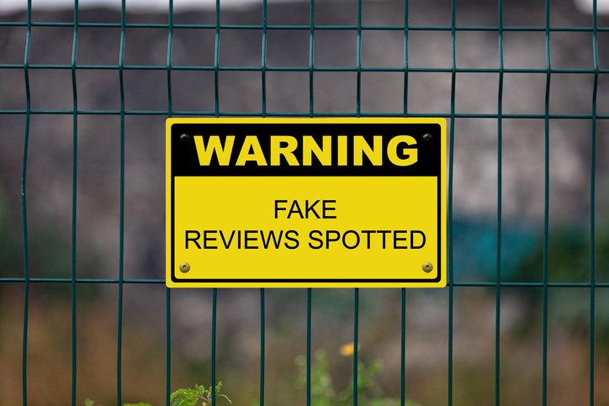
Fake Review Detection
The original reviews database is the input to the first process, the Fake review discovery. Some logical rules that are used to detect fake reviews are stated below:
Same reviewer posting reviews frequently about the same product
Many reviews being posted about the same product at the same time
A particular user gives only the highest or the lowest rating to every product
Multiple references to other people such as 'my family,' 'my sister,' etc.

Slide 10

Opinion Mining
Then the next process is Opinion Mining. Opinion Mining is performed on the genuine reviews database. It consists of two sub-processes: NLP and Sentiment Analysis.

Slide 11
Sentimental Analysis
Sentiment analysis, also referred to as opinion mining, is an approach to natural language processing (NLP) that identifies the emotional tone behind a body of text.
This is a popular way for organizations to determine and categorize opinions about a product, service, or idea.
Sentiment analysis aims at analyzing and extracting knowledge from the subjective information published on the Internet. Due to its vast range of academic and industrial applications as well as exponential growth of Web 2.0, sentiment analysis has been a hot research field in data mining and natural language processing (NLP) recently

Slide 12
Product Rating
This database is the input to the last process of Clustering. Since Amazon follows the 5-star rating scheme, we also have to rate the products out of 5. For this, we need to create 5 different clusters depending on the average sentiment scores of the reviews.
Three different algorithms are used for clustering: Kmeans, hierarchical and DBScan . After clustering, each review is assigned a cluster. Depending on the cluster of reviews, each review will be given a rating between 1 and 5 and the average will be taken to get the final rating for each product.

Slide 13
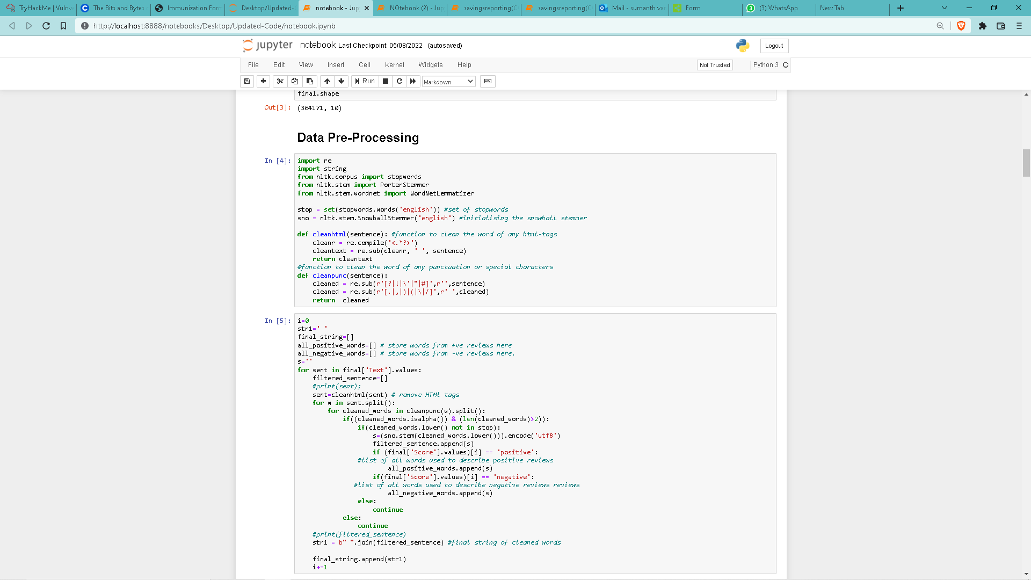
Code

Slide 14
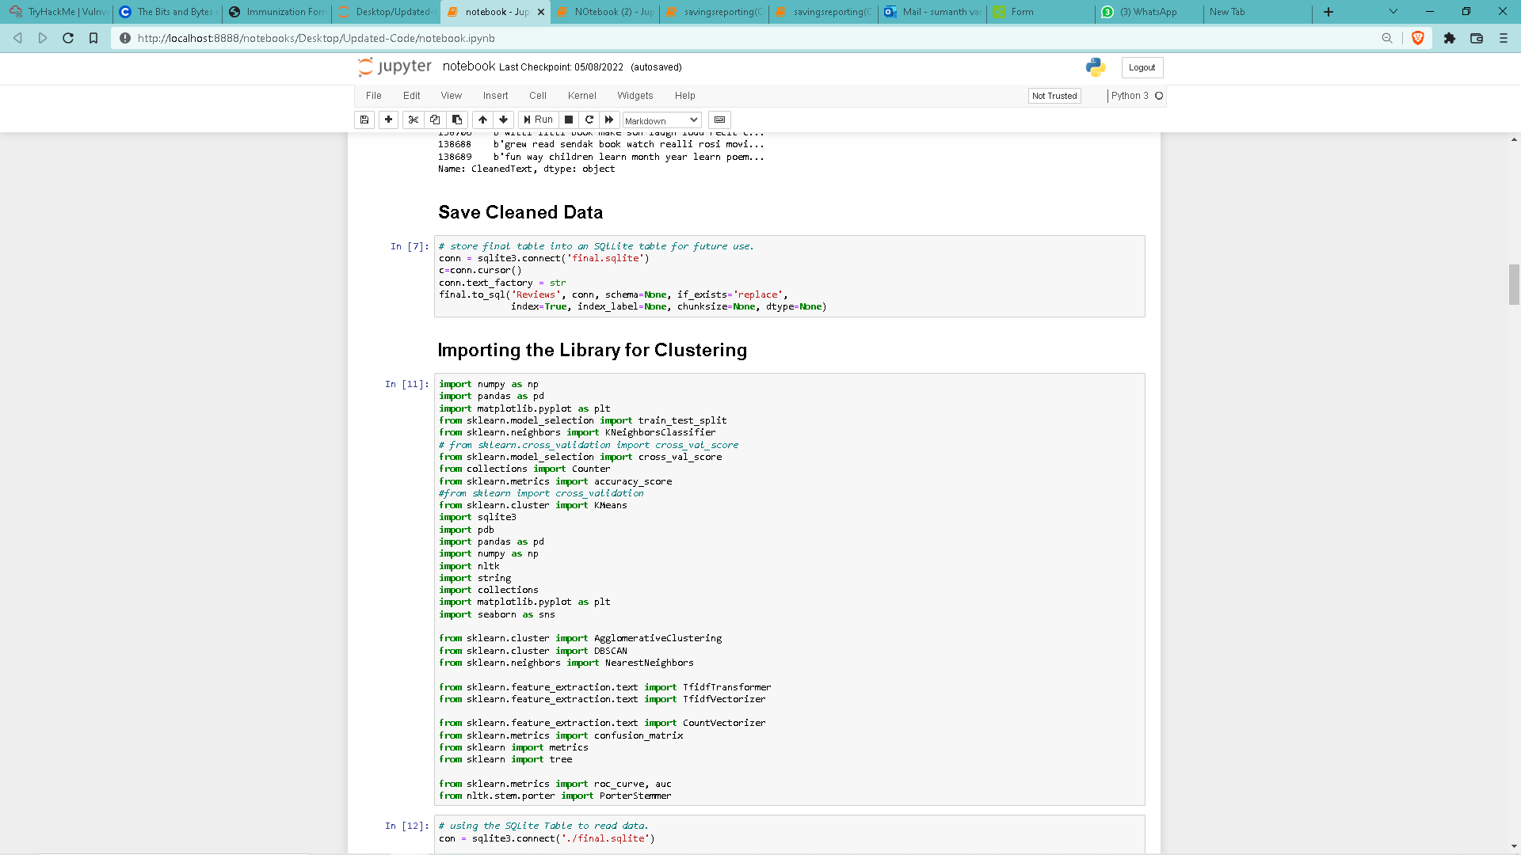

Slide 15
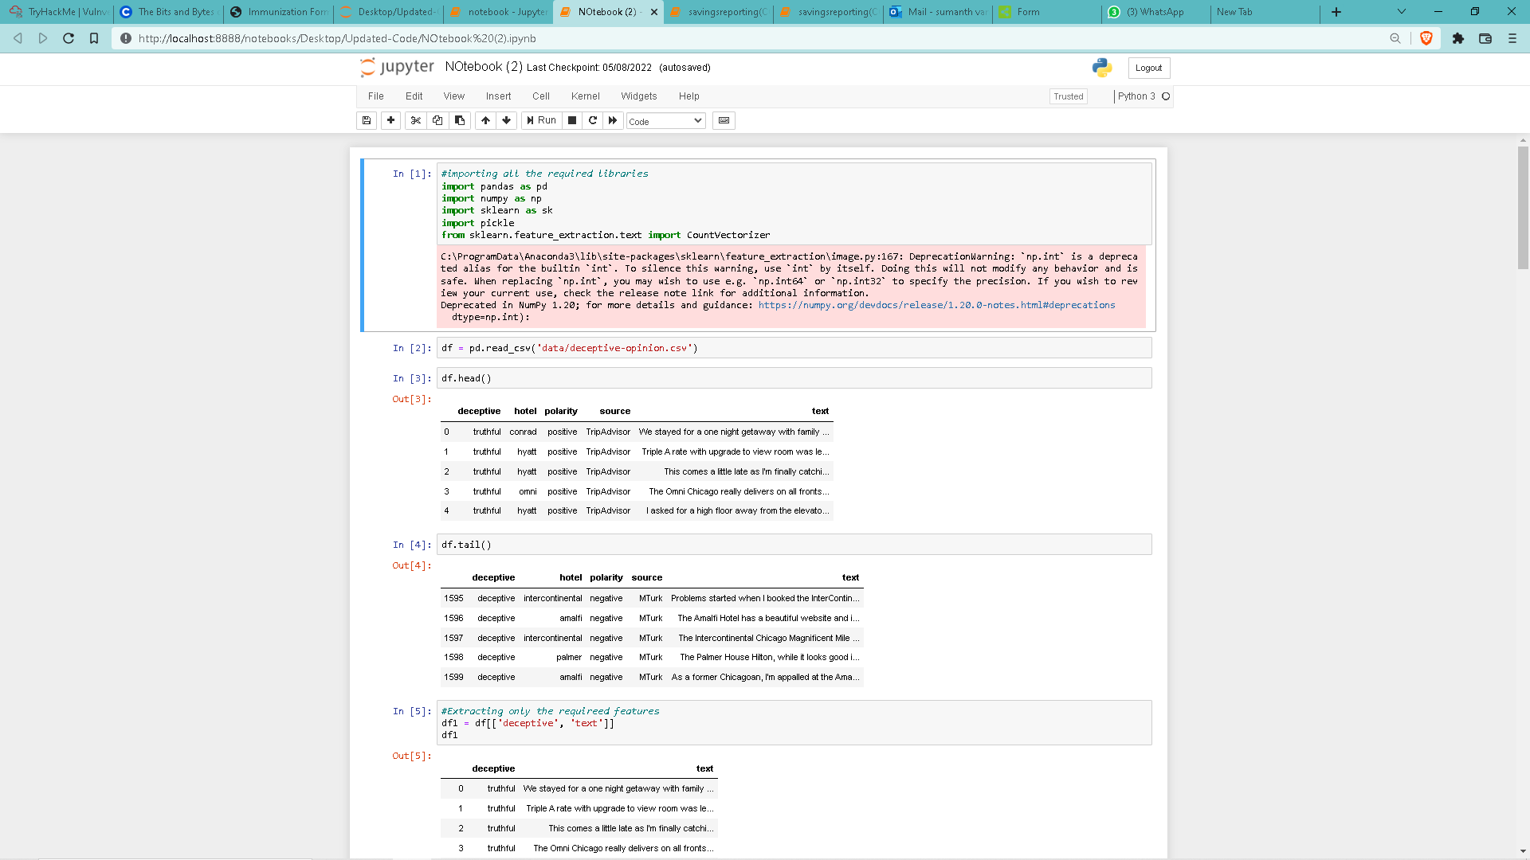

Slide 16
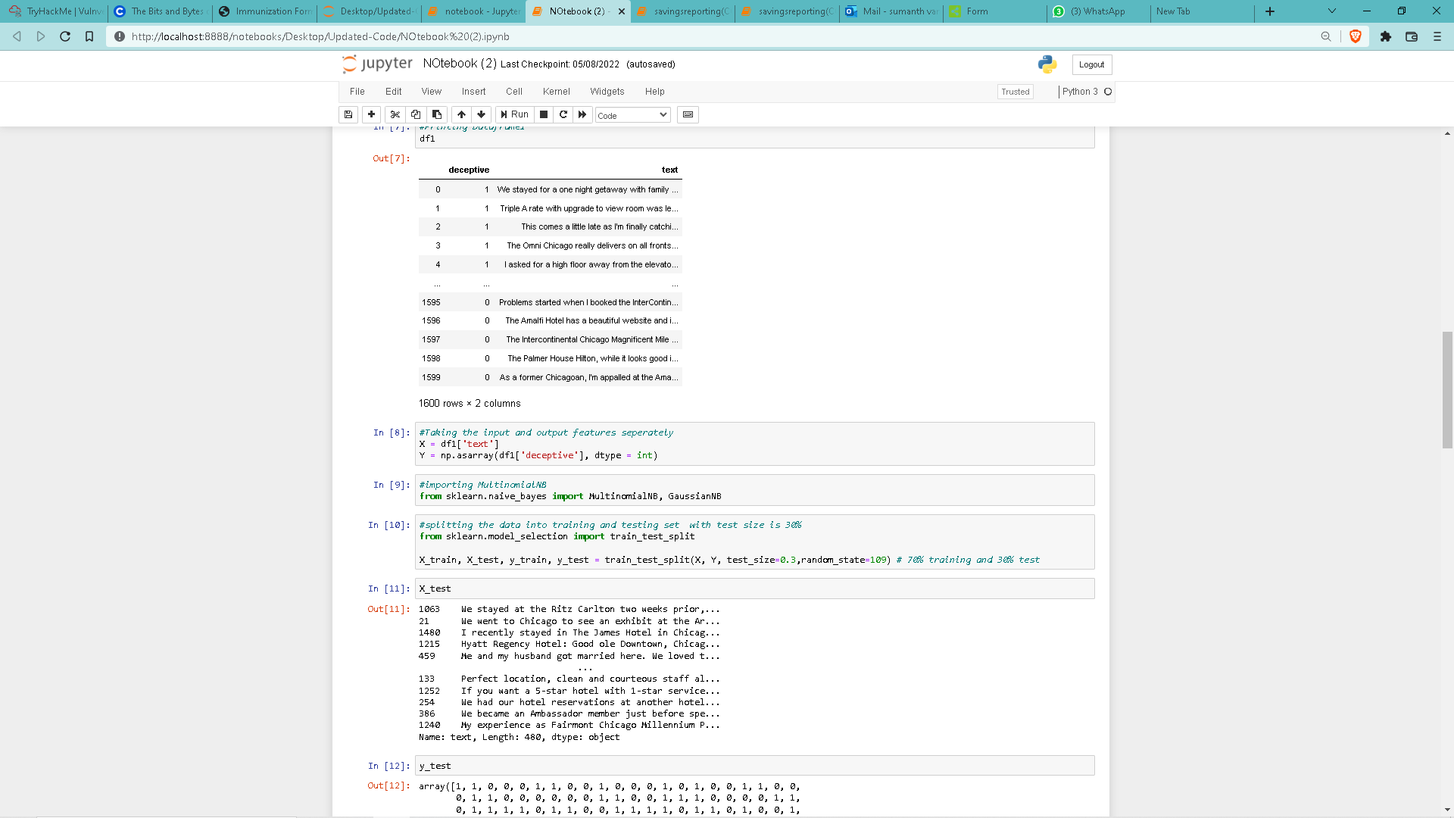

Slide 17
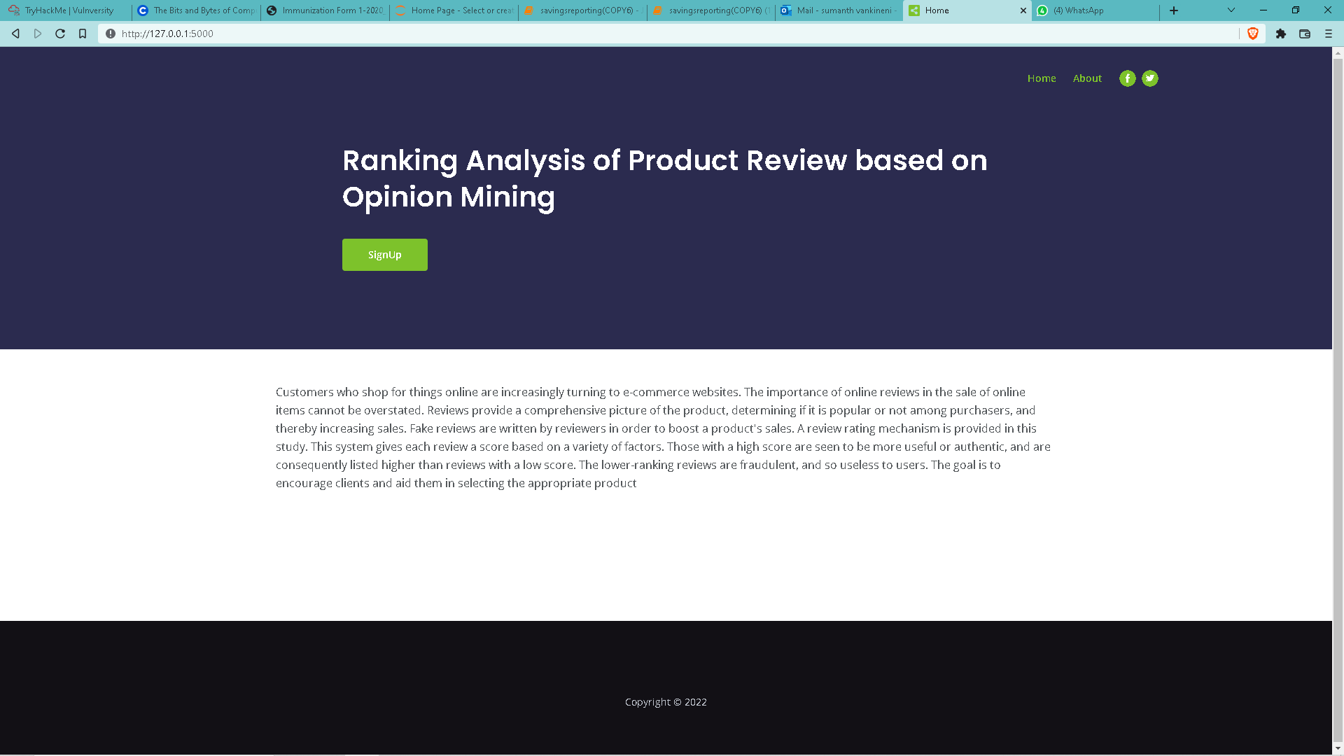
Outputs

Slide 18
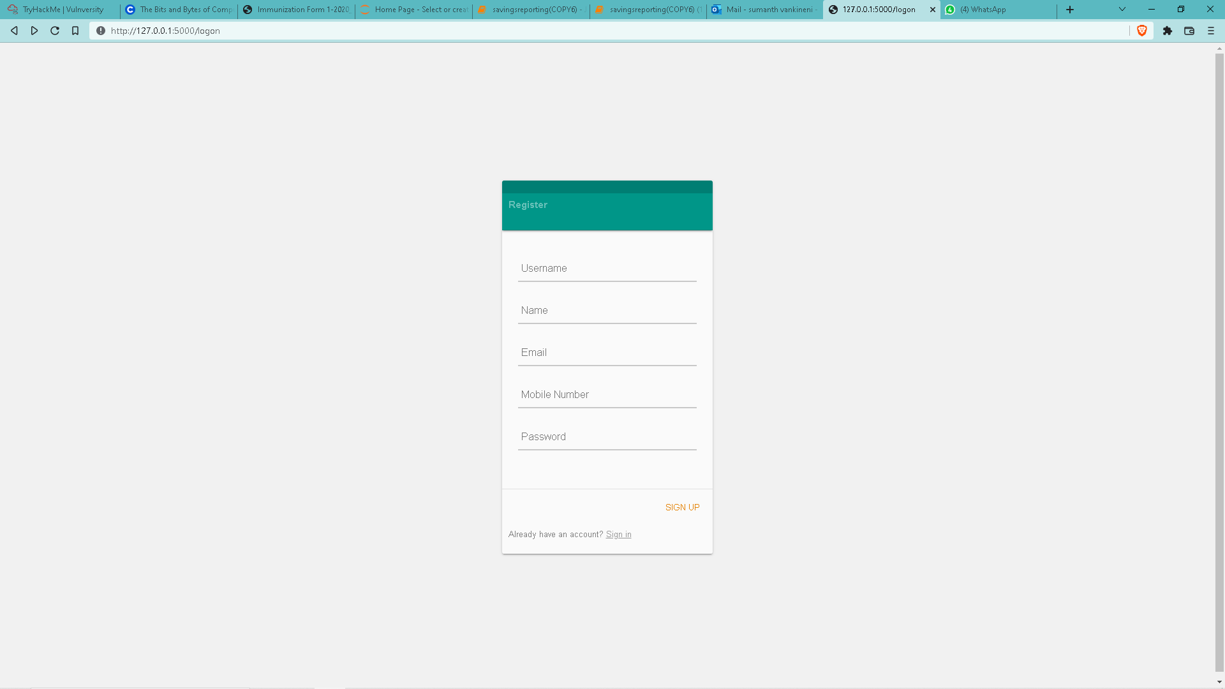

Slide 19
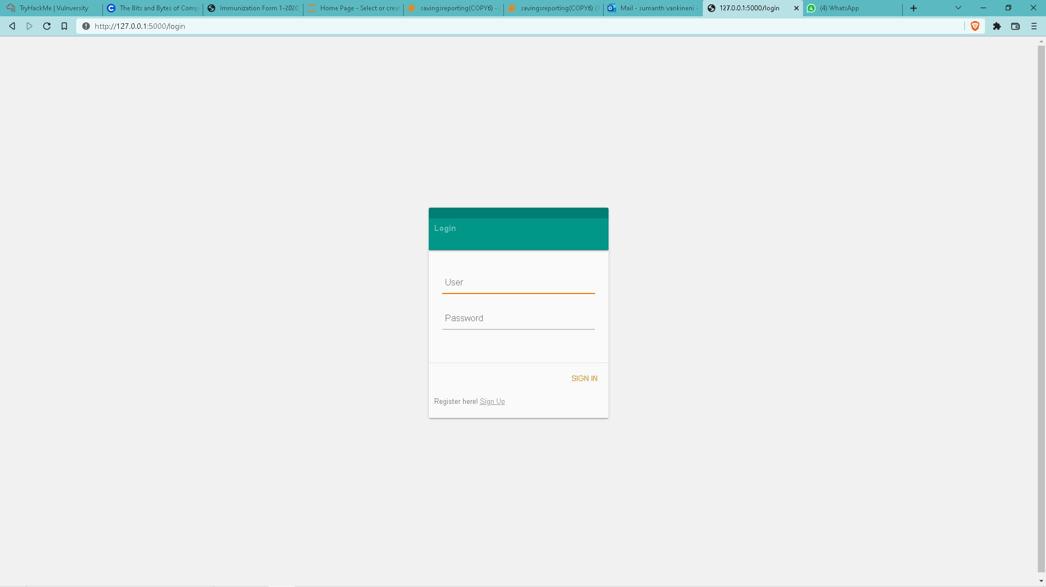

Slide 20
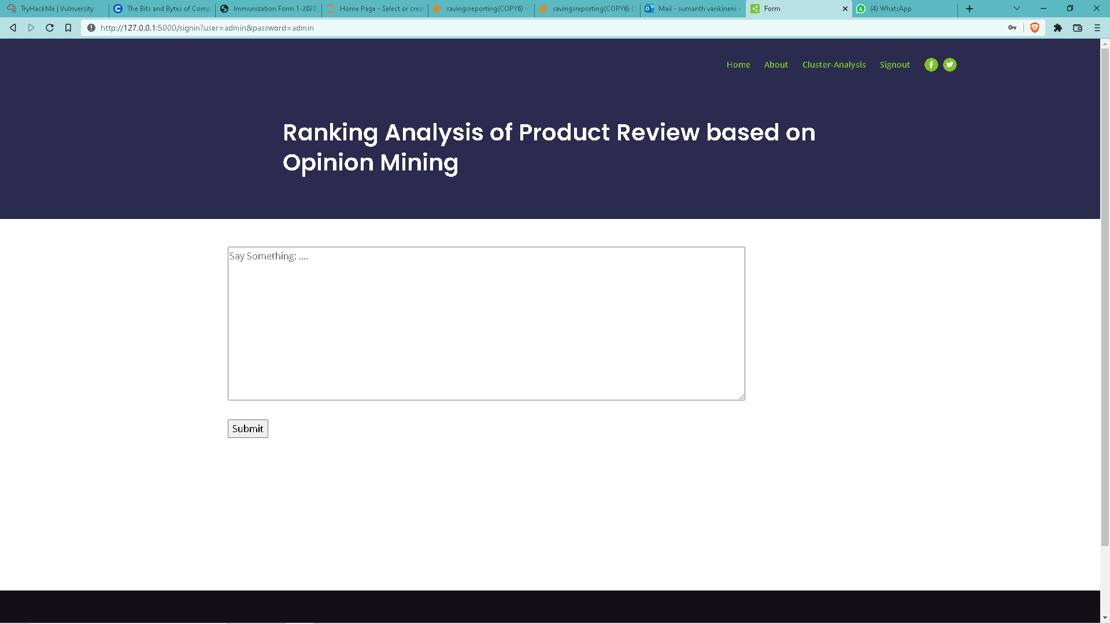

Slide 21
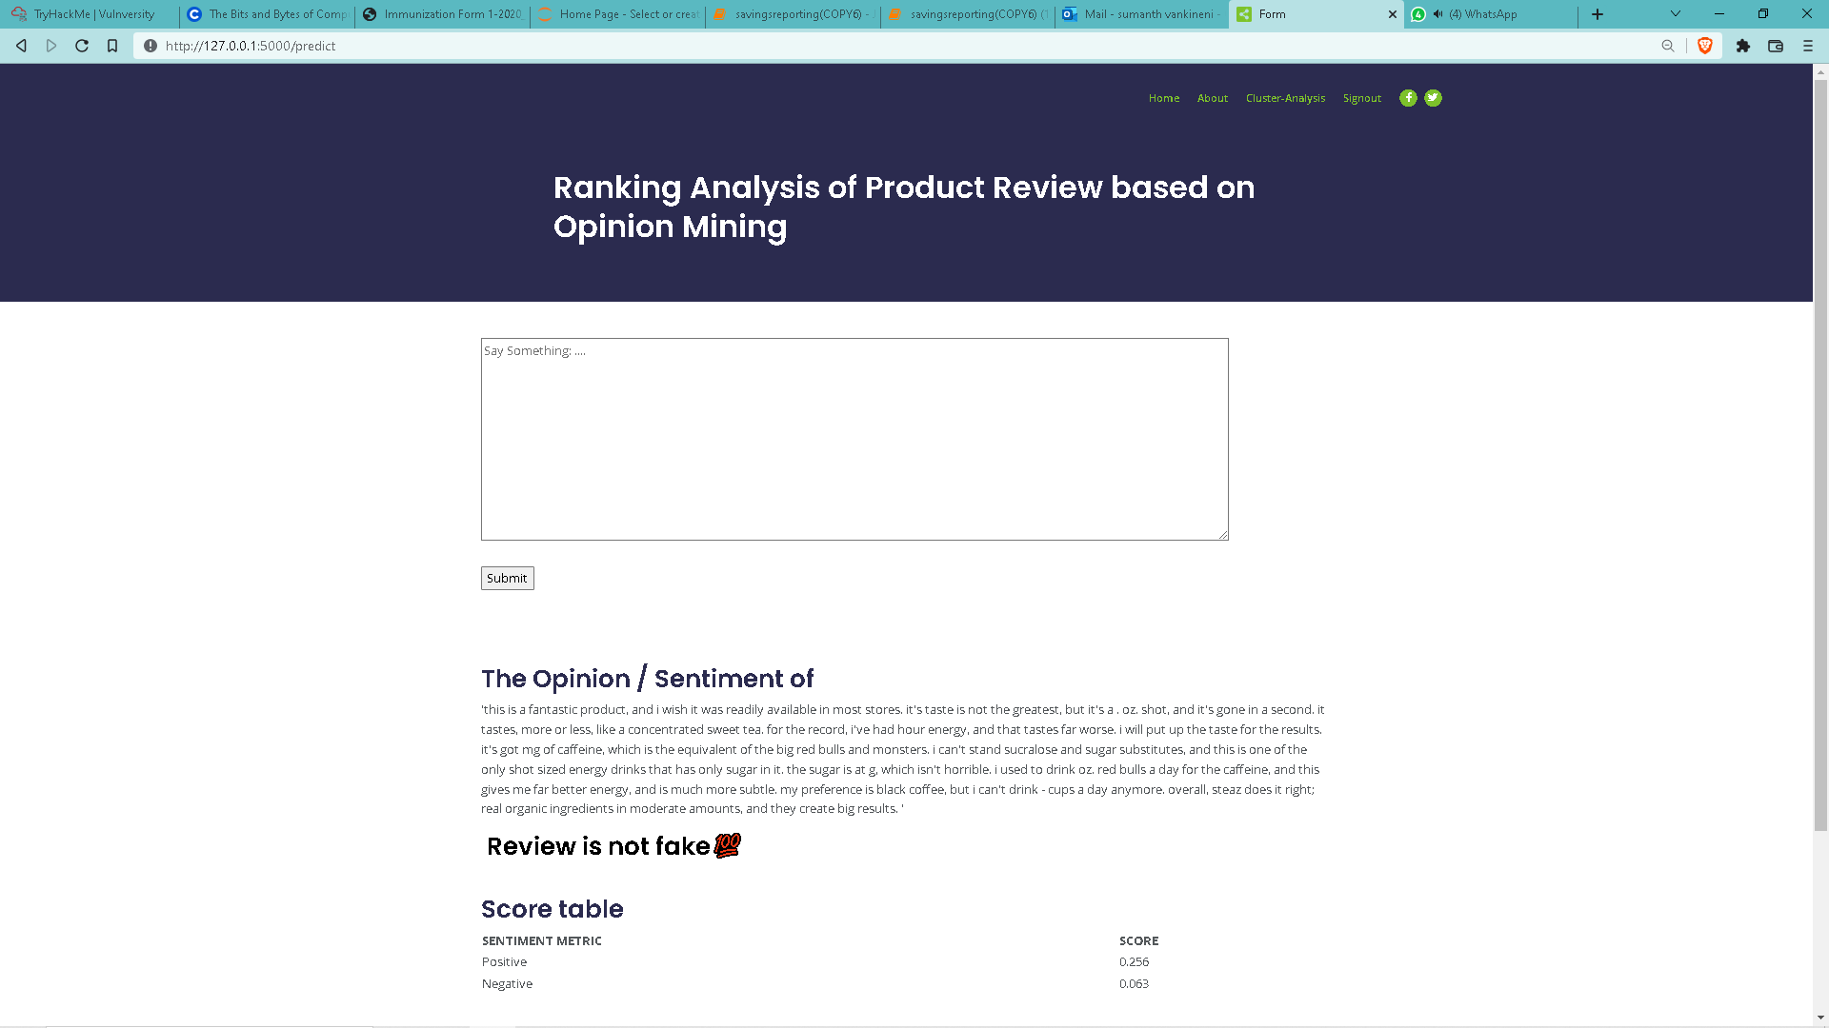

Slide 22
Conclusion
Our proposed system first removes fake reviews and then performs opinion mining on only genuine reviews to rate the products.
Since only genuine reviews are selected, our proposed system is expected to generate more dependable results for the customer to refer to and decide whether to buy a product or not.

Slide 23
Future Scope
These days a few people are using acronyms and some short words with spelling mistakes which aren’t present in the dictionaries we used in sentiment analysis, so we have to work on such content of words to get the better accuracy with the changes in slangs of shorts-words.
With our current implementation we’ve built a web application under which out code runs but later on we can directly partner with the e-commerce websites to avoid the hassle of opening another websites to get the analysis of the reviews.

Slide 24
Thank You!

